Slide 1
Video Translation using Deep Learning
Chirag Bellara
Rohit Ramkumar
Sai Suraj Matta Veera Venkata
Al Shafayet Haque Silvy

Slide 2
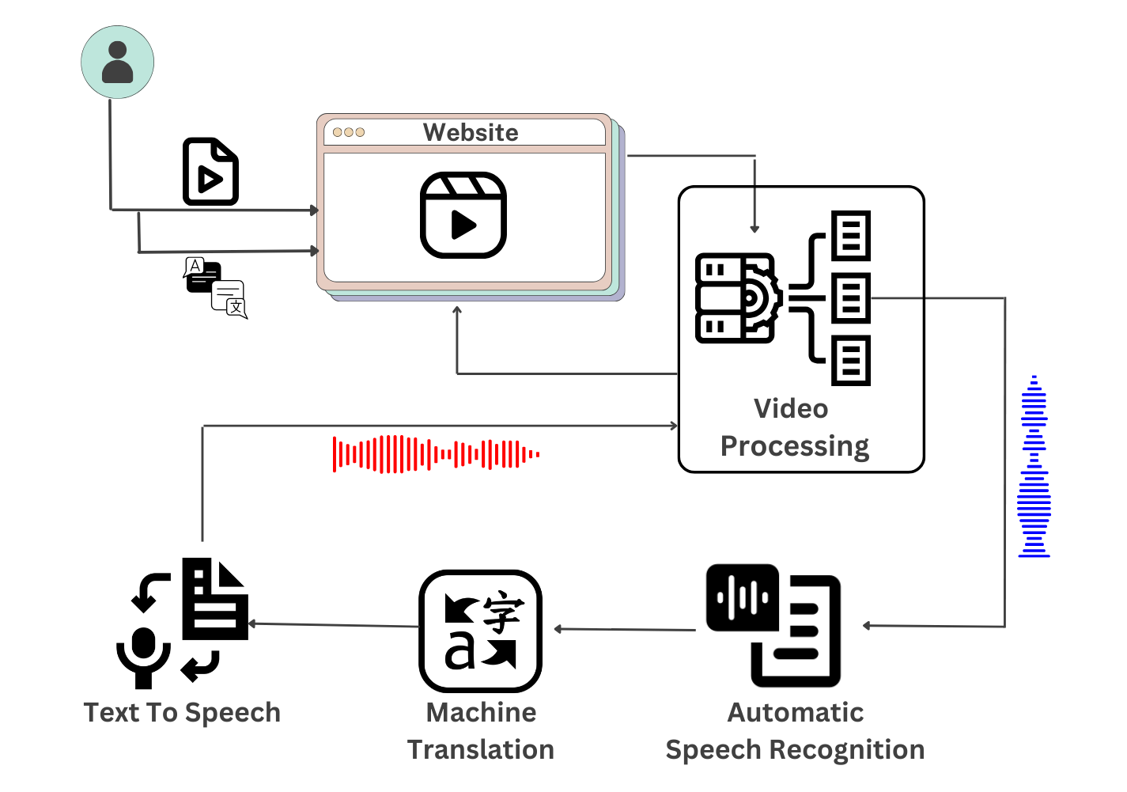
Project Workflow

Slide 3
Must-Have Features
Functional Requirements
Non-Functional Requirements
User should be able to upload a video or input a video link.
User should be able to select the language to which the video should be translated to.
The video should begin processing once the user clicks on the translate/process button.
The final translated video must be displayed to the user and the user should be able to play the video.
Translation Accuracy.
Speech rate synchronization
Continuous Model Updates
Feedback Loop for Model Improvement
Cross-platform Compatibility
User Experience

Slide 4
Good-to-Have Features
Functional Requirements
Non-Functional Requirements
Audio syncing after translation
Voice Cloning
Adaptability to Different Languages and Accents.
User Profiles and History
Real-time Collaboration
Offline Mode
The processing time for a video should be minimum.
Consistency in translations
Naturalness and Fluency
Cross-Cultural Sensitivity
Availability
In-App Chat or Support
Accessibility Features

Slide 5
Thank You.

